Slide 1
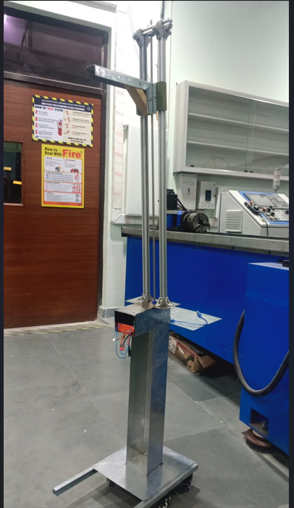
Portable Xray stand
Team Members-
Adarsh
Dhaval
Anjali
Krishita
Ritik

Slide 2
Shops used
Sheet metal
Digital Manafacturing
Welding
Fabrication
CNC
Woodworking
3-d printing

Slide 3
Individual Contributions
Adarsh | Dhaval | Anjali | Krishita | Ritik
Electronics | Sheet metal | Fabrication | Fabrication | Welding
Sheet metal | Fabrication | Sheet metal | Welding | Fabrication
3-d printing ,Cad models | Welding | Machine shop | Sheet metal | Wood working
Fabrication | Machine shop | 3-d print | Wood working | Sheet metal
Welding | Wood working | CNC | Machine shop | DMF
CNC | Electronics | DMF

Slide 4
Machines Used
Sheet metal: Metal sheet cutter, Laser cutter, Sheet bending machine
Fabrication: hand drill machine, drill
CNC: Water-jet cutting
Welding: SMAW, spot welding, Laser welding
3-d printing: Creality printer (with fusion software)
Wood working: Table Saw
DMF: Arduino Uno, 14.8V battery, Jumper wires, Motor driver

Slide 5
Innovation
Our main innovation was using software for input instead of mechanical buttons. It provided greater accuracy and control over the motion of the X-ray head. We can easily shift the position of the X-ray head to any position we wish. It is also easily scalable in the future, as we could change the code and put the stand under our control without any extra expenditure on new components. We also added locking-type wheels to lock the stand in that position.

Slide 6
Our takeaway and acknowledgement
We all had fun building this project, and we learned how an idea is converted into a real-life product. One thing we noticed is that as we build a product, some ideas come only when we try to build it. For example, we had difficulty in welding the upper aluminium extrusion and the Mild steel sheet. At that point in time, we got the idea of using screws and an L-bracket.
I would especially like to thank Mr Pulak Pandey, lab staff, and TAs who showed us constant support and help in providing us with all the material we required.

